Slide 1

Week 2
Mentorness Internship:
Hotel Reservation Analysis
~ By Faiqua Sadiq

Slide 2
Table of contents
01
Objective
05
Dataset Analysis
02
Table Overview
06
Key Findings
03
Dataset Metrices
07
Conclusison
04
Datatypes & SQl Concepts

Slide 3

Objective
The Hotel Reservation Analysis project aims to leverage SQL to extract valuable insights from booking data. By analysing historical booking trends, the project seeks to optimize revenue generation by identifying booking and cancellations, popular room types, etc. Additionally, customer segmentation will be utilized to personalize marketing efforts and enhance guest experiences. Through data-driven insights, the project aims to streamline booking processes, enhance customer satisfaction, and maintain a competitive edge in the hospitality industry.

Slide 4
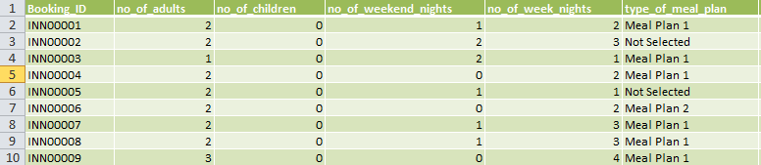
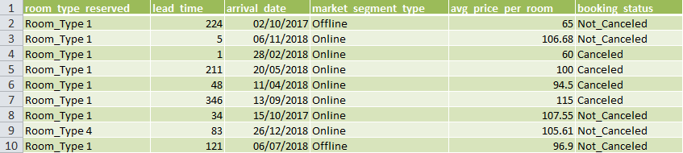
Table Overview

Slide 5
Dataset Metrices
The dataset provided has the following headers:
1. Booking_ID: It is the Unique identifier for each hotel reservation booking which allows for tracking and referencing individual bookings within the dataset.
2. no_of_adults: Indicates the number of adults included in each reservation.
3. no_of_children: Specifies the number of children included in each reservation. It Provides insight into the size of the booking party and accommodation needs..
4. no_of_weekend_nights: Represents the number of nights booked for weekends (typically Friday and Saturday nights).Helps in analyzing booking patterns and identifying peak demand periods.
5. no_of_week_nights: Denotes the number of nights booked for weekdays (non-weekend nights). Offers insights into the duration of stays and preferences for weekday versus weekend accommodations.
6. type_of_meal_plan: Indicates the meal plan selected for each reservation. Provides information on guest preferences and expectations regarding dining options.

Slide 6
Dataset Metrices
7. room_type_reserved: Specifies the type of room reserved for each booking. Helps in understanding room preferences and optimizing room allocation strategies.
8. lead_time: Represents the lead time between booking and arrival dates in days. Provides insights into booking behavior.
9. arrival_date: Indicates the arrival date for each reservation. Essential for scheduling and managing room availability.
10. market_segment_type: Identifies the market segment to which each reservation belongs (e.g., online, offline, Corporate, Aviation). Assists in targeting marketing efforts and tailoring services to specific customer segments.
11. avg_price_per_room: Represents the average price per room for each reservation. Offers insights into pricing strategies, revenue generation, and customer spending patterns.
12. booking_status: Indicates the status of each reservation (e.g., Cancelled or not cancelled bookings). Helps in tracking the progress and completion of bookings, as well as managing inventory and availability.

Slide 7
Data Types & SQL Concepts Used
Data Types
The dataset comprises a variety of metrics, including varchar, integer, float and date-time data types. This diverse range of data types enables comprehensive analysis and insights across different dimensions of the dataset.
Advance SQL Concepts Used
Aggregate functions: sum(),count(), avg()
subqueries
Window Functions: RANK(), DENSE_RANK(), ROW_NUMBER()
CASE Expressions

Slide 8



Dataset Analysis
Problem statement 1. What is the total number of reservations in the dataset?
select COUNT(*) as total_bookings from Hotel_Rsvn_Dataset
Problem statement 2 Which meal plan is the most popular among guests?
select top 1 type_of_meal_plan, count(type_of_meal_plan) as total_orders from Hotel_Rsvn_Dataset
group by type_of_meal_plan
order by total_orders desc
OR
select * from
(select type_of_meal_plan,count(type_of_meal_plan) as total_orders,
RANK() over(order by count(type_of_meal_plan) desc) as rn
from Hotel_Rsvn_Dataset
group by type_of_meal_plan) a
where rn=1

Slide 9

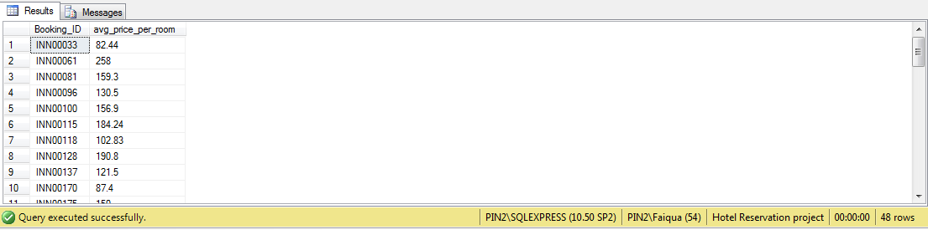

Dataset Analysis
Problem statement 3. How many reservations were made for the year 20XX (replace XX with the desired year)?
select YEAR(arrival_date) Year_of_booking,COUNT(*) no_of_rsvn
from Hotel_Rsvn_Dataset
group by YEAR(arrival_date)
Problem statement 4. What is the average price per room for reservations involving children?
select Booking_ID,avg_price_per_room
from Hotel_Rsvn_Dataset
where no_of_children !=0
Problem statement 5. How many reservations fall on a weekend (no_of_weekend_nights > 0)?
select COUNT(*) no_of_rsvn_on_weekends
from Hotel_Rsvn_Dataset
where no_of_weekend_nights>0

Slide 10



Dataset Analysis
Problem statement 6. What is the most commonly booked room type?
select top 1 room_type_reserved, count(room_type_reserved) as common_room_type
from Hotel_Rsvn_Dataset
group by room_type_reserved
order by common_room_type desc
OR
select * from
(select room_type_reserved,count(room_type_reserved) as common_room_type,
RANK() over(order by count(room_type_reserved) desc) as rn
from Hotel_Rsvn_Dataset
group by room_type_reserved) a
where rn=1
Problem statement 7. What is the most common market segment type for reservations?
select top 1 market_segment_type,COUNT(*) count_market_segment_type from Hotel_Rsvn_Dataset
group by market_segment_type
order by count_market_segment_type desc

Slide 11


Dataset Analysis
Problem statement 8. What is the highest and lowest lead time for reservations?
select *,
case
when lead_time_rank=1 then 'Highest Lead Time'
when lead_time_rank=700 then 'Lowest Lead Time'
end as Lead_Time_Status
from
(select lead_time,
row_number() over(order by lead_time desc) lead_time_rank
from Hotel_Rsvn_Dataset) a
where lead_time_rank in (1,700)
Problem statement 9. How many reservations have a booking status of "Confirmed"?
select count(booking_status) as confirmed_bookings from Hotel_Rsvn_Dataset
where booking_status = 'Not_Canceled'

Slide 12


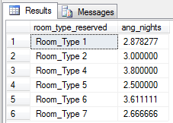
Dataset Analysis
Problem statement 10. What is the total number of adults and children across all reservations?
select sum(no_of_adults) total_adults ,sum(no_of_children) total_children from Hotel_Rsvn_Dataset
Problem statement 11. What is the average number of weekend nights for reservations involving children?
select AVG(no_of_weekend_nights) as avg_weekend_night from Hotel_Rsvn_Dataset
where no_of_children>0
Problem statement 12. . What is the average number of nights (both weekend and weekday) spent by guests for each room type?
select room_type_reserved, avg(no_of_weekend_nights+no_of_week_nights) ang_nights
from Hotel_Rsvn_Dataset
group by room_type_reserved

Slide 13
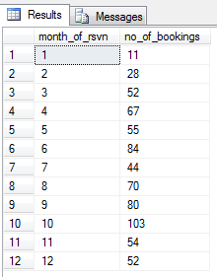

Dataset Analysis
Problem statement 13. How many reservations were made in each month of the year?
select month(arrival_date) as month_of_rsvn ,COUNT(Booking_ID) as no_of_bookings from Hotel_Rsvn_Dataset
group by month(arrival_date)
Problem statement 14. For reservations involving children, what is the most common room type, and what is the average price for that room type?
select top 1 room_type_reserved, COUNT(*) no_reg ,round(avg(avg_price_per_room),0) avg_price
from Hotel_Rsvn_Dataset
where no_of_children!=0
group by room_type_reserved
order by no_reg desc
OR
select * from
(select room_type_reserved,COUNT(*) no_reg,round(avg(avg_price_per_room),0) avg_price,
DENSE_RANK() over(order by COUNT(*) desc) rnk
from Hotel_Rsvn_Dataset
where no_of_children!=0
group by room_type_reserved) b
where rnk=1

Slide 14


Dataset Analysis
Problem statement 15. Find the market segment type that generates the highest average price per room.
select top 1 market_segment_type, round(avg(avg_price_per_room),0) as avg_price_market_segment from Hotel_Rsvn_Dataset
group by market_segment_type
order by avg_price_market_segment desc
OR
select * from
(select market_segment_type,round(avg(avg_price_per_room),0) as avg_price_market_segment,
DENSE_RANK() over(order by round(avg(avg_price_per_room),0) desc) rnk
from Hotel_Rsvn_Dataset
group by market_segment_type) b
where rnk=1

Slide 15

Key Findings
Total number of bookings – 700
The data set consists of data of the years 2017 having 123 bookings and 2018 having 577 bookings
The online type of market segment has the highest bookings of 518 generating the highest revenue.
There are a total of 493 confirmed bookings.
"Room Type 1 accounts for the highest number of bookings, with a total of 534 reservations.
Room type 4 has the highest number of nights booked.
A total of 383 bookings are for weekends, specifically Saturdays and Sundays.
The lead time ranges from 0 to 443 days, with the highest lead time being 443 days and the lowest being 0 days.
A total of 1316 adults and 69 children have made reservations, with an average of 1 weekend night reserved for each child.
The number of bookings in each month is found out and june, august, september, october are the peak booking.
Meal Plan 1 leads with 527 orders, indicating its strong popularity among users.

Slide 16
Conclusion
The hotel reservation analysis SQL project offers a comprehensive examination of booking data to uncover trends and patterns. Through analysis of metrics such as booking frequency, lead time, and customer segmentation, the project identifies peak booking periods, popular room types, and preferred meal plans. Insights gained from the analysis inform revenue optimization strategies, including pricing adjustments and targeted marketing efforts. Additionally, the project facilitates operational enhancements such as inventory management optimization and fraud detection. Overall, the project's findings enable hotels to make data-driven decisions that enhance guest experiences, maximize revenue, and maintain competitiveness in the hospitality industry.

Slide 17
Thank you

